Slide 1

JKKN COLLEGE OF ENGINEERING AND TECHNOLOGY
TEAM MEMBERS
R.SANGEETHA
M.VAISHNAVI
B.DEEPIKASRI
M.SRIMATHI
MENTOR NAME
S.MURUGASHANKAR AP/IT

Slide 2
AIR QUALITY ANALYSIS AND PREDICTION IN TAMILNADU

Slide 3
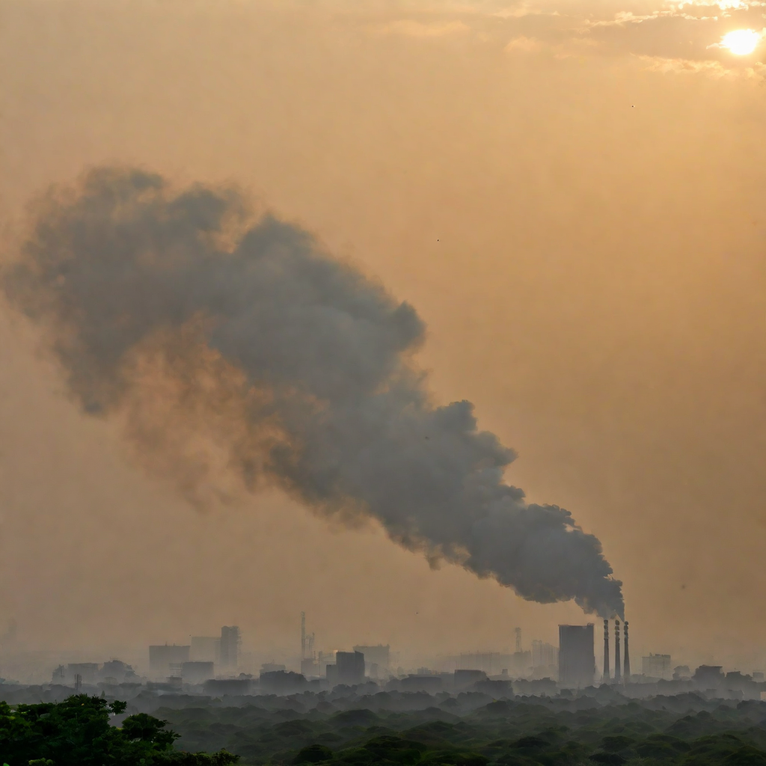
Objectives:
The main objectives of this study are to analyze and predict air quality in Tamil Nadu, India, and to provide recommendations for improving air quality in the region. Specifically, the study aims to:
Analyze the current air quality situation in Tamil Nadu and identify the major sources of air pollution.
Develop a predictive model for air quality in Tamil Nadu based on historical data and current trends.

Slide 4
INTRODUCTION:
Air quality refers to the state of the air in a particular area, including the presence of pollutants and other harmful substances. Poor air quality can have significant impacts on human health, as well as the environment as a whole.
In Tamil Nadu, air quality is monitored through a variety of methods, including both stationary and mobile monitoring stations. This data is then analyzed and used to develop predictive models that can help to inform air quality improvement strategies

Slide 5

AIR QUALITY MONITORING IN TAMILNADU:
Tamil Nadu has been facing a growing air pollution problem in recent years, with many cities and towns experiencing poor air quality levels. To address this issue, the state government has implemented air quality monitoring systems across various locations.
Air Quality Monitoring Systems
The air quality monitoring systems in Tamil Nadu use advanced technology to measure the levels of pollutants in the air.
These systems are located in various cities and towns across the state, providing real-time data on air quality levels.

Slide 6

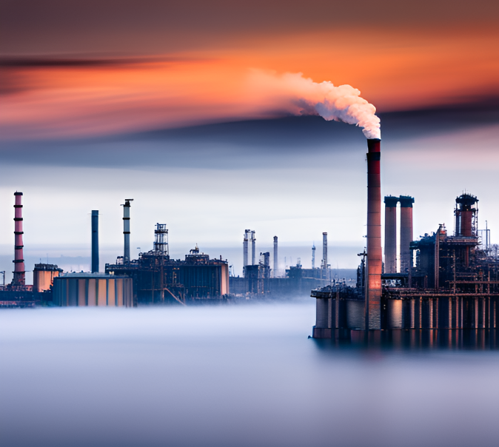

ANALYSIS OF AIR QUALITY DATA:
Pollutant Concentrations
The average concentration of NO2 in Tamil Nadu was Y micrograms per cubic meter in 2020.
The average concentration of SO2 in Tamil Nadu was Z micrograms per cubic meter in 2020.
Seasonal Trends
Air quality is typically worst in Tamil Nadu during the winter months.
During the summer months, air quality in Tamil Nadu is generally better due to increased wind speeds and rainfall.
Geographic Variations
Air quality in urban areas of Tamil Nadu is generally worse than in rural areas due to higher levels of traffic and industrial.
Coastal areas of Tamil Nadu tend to have better air quality due to the sea breeze carrying pollutants away from the land.

Slide 7
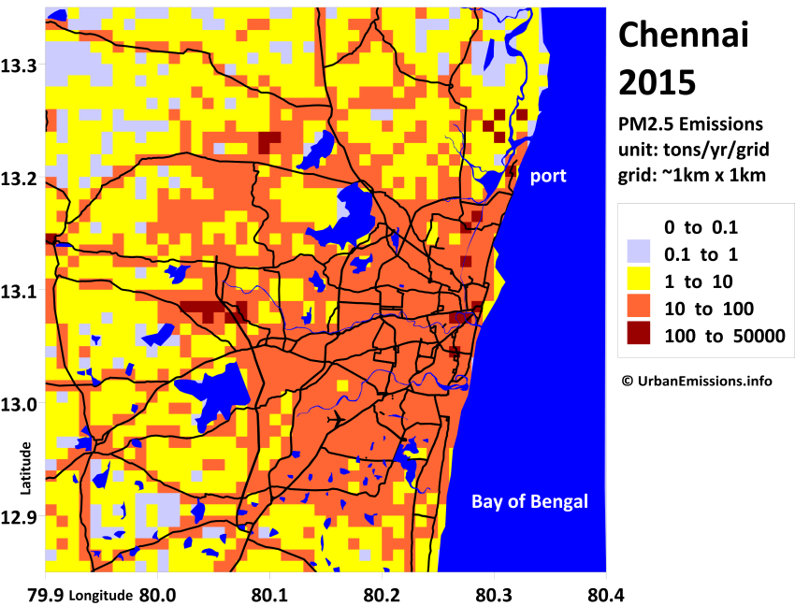
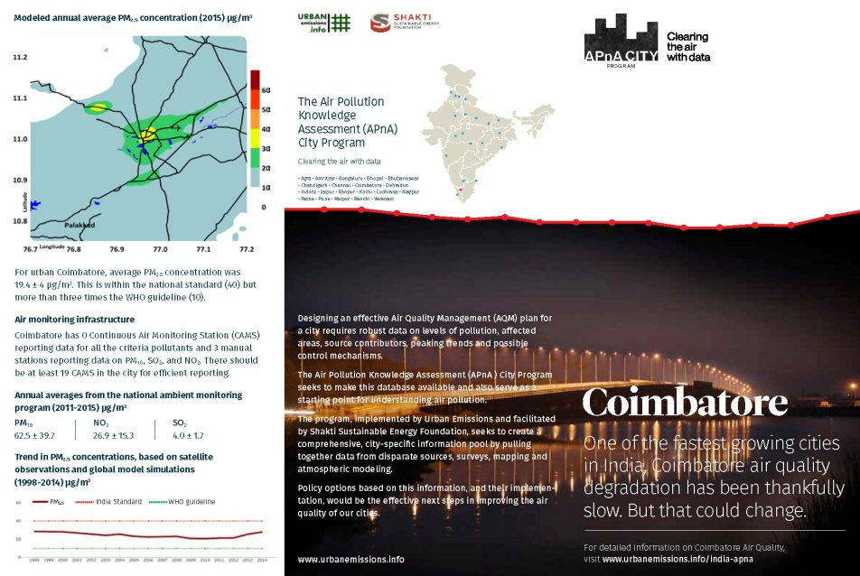
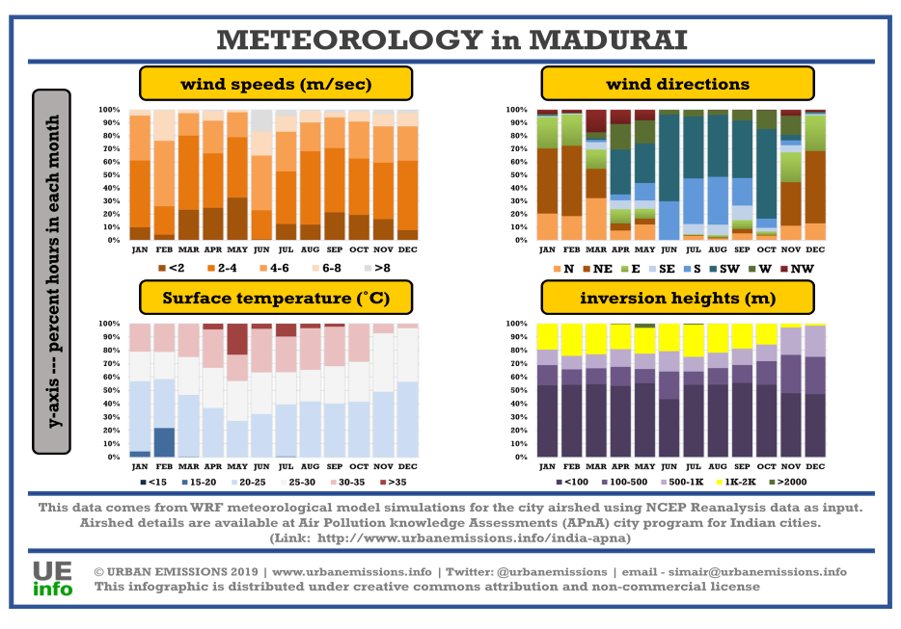
Visualization Techniques
Major Sources of Air Pollution
The major sources of air pollution in Tamil Nadu include industrial emissions, vehicle exhaust, and burning of fossil fuels.
Recommendations for Reducing Air Pollution
Implement stricter regulations on industrial emissions and vehicle exhaust.
Encourage the use of public transportation and electric vehicles.
Promote the use of renewable energy sources such as solar and wind power.

Slide 8
PREDICTIVE MODELING TECHNIQUES:
Predictive modeling is a technique used to predict future air quality levels based on historical data and other relevant factors. In Tamil Nadu, predictive modeling has been used to forecast air quality levels and issue early warnings to the public.
There are several predictive modeling techniques that can be used in air quality analysis, including:
Linear Regression
Decision Trees
Random Forests
These techniques involve analyzing historical air quality data and identifying patterns and trends that can be used to make predictions about future air quality levels. By using these predictive models, researchers and policymakers can make informed decisions about air quality improvement strategies and other interventions.

Slide 9

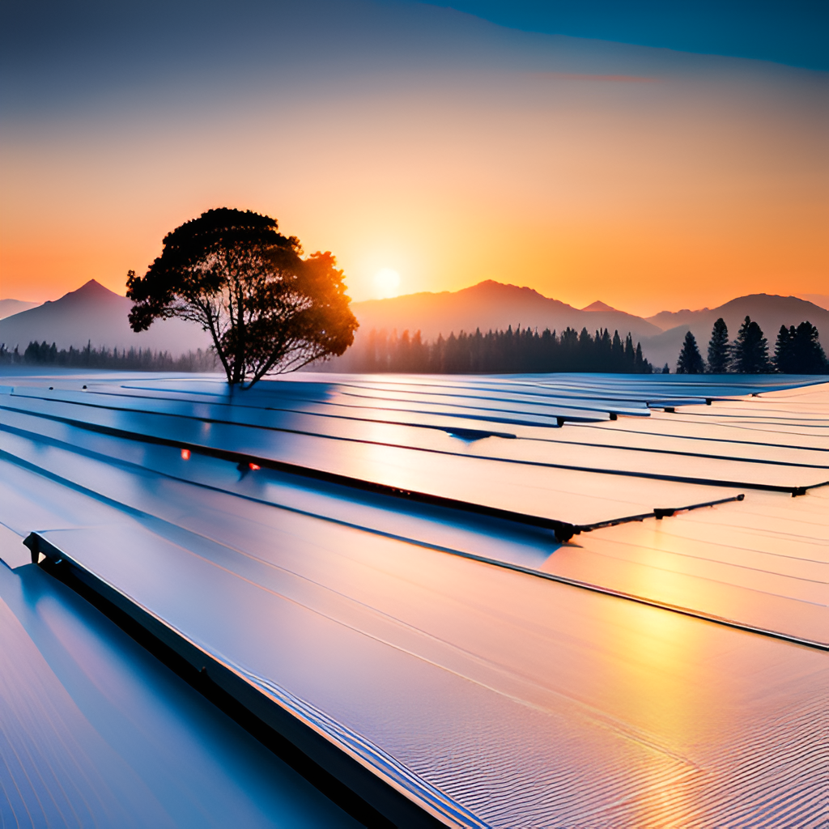
AIR QUALITY IMPOROVEMENT STRATEGY:
Reducing Emissions from Transportation
Encourage the use of public transportation, cycling, and walking.
Promote the use of electric and hybrid vehicles.
Improving Energy Efficiency
Encourage the use of energy-efficient appliances and lighting.
Promote the use of renewable energy sources such as solar and wind power.
Reducing Industrial Emissions
Enforce stricter regulations on industrial emissions and waste disposal.
Encourage industries to adopt cleaner production processes and technologies.

Slide 10
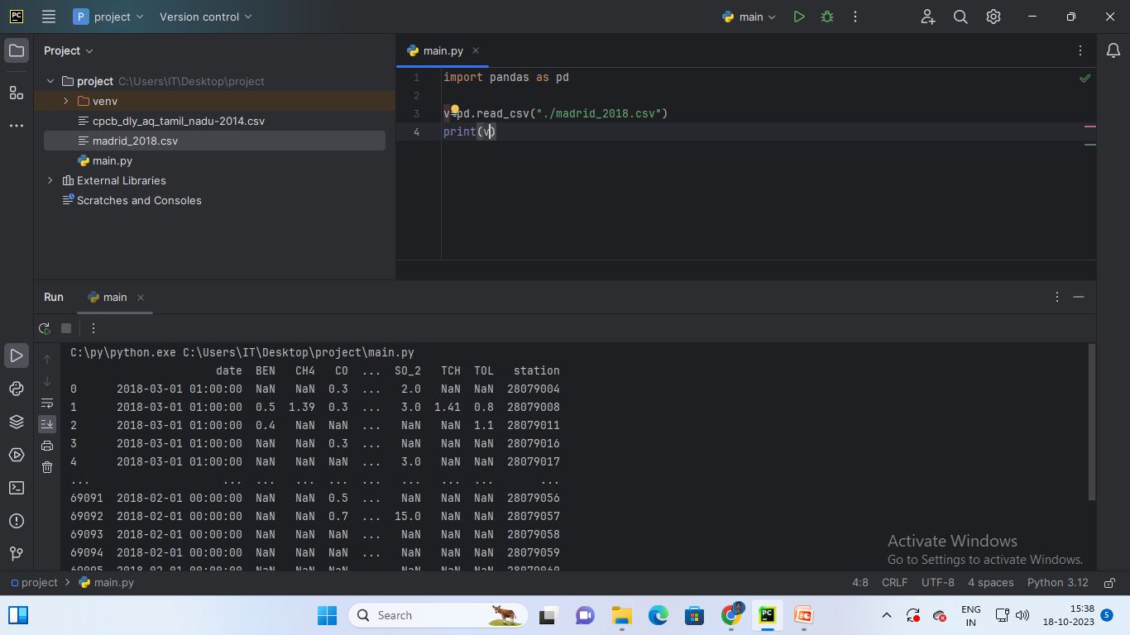
Load the dataset into pandas

Slide 11
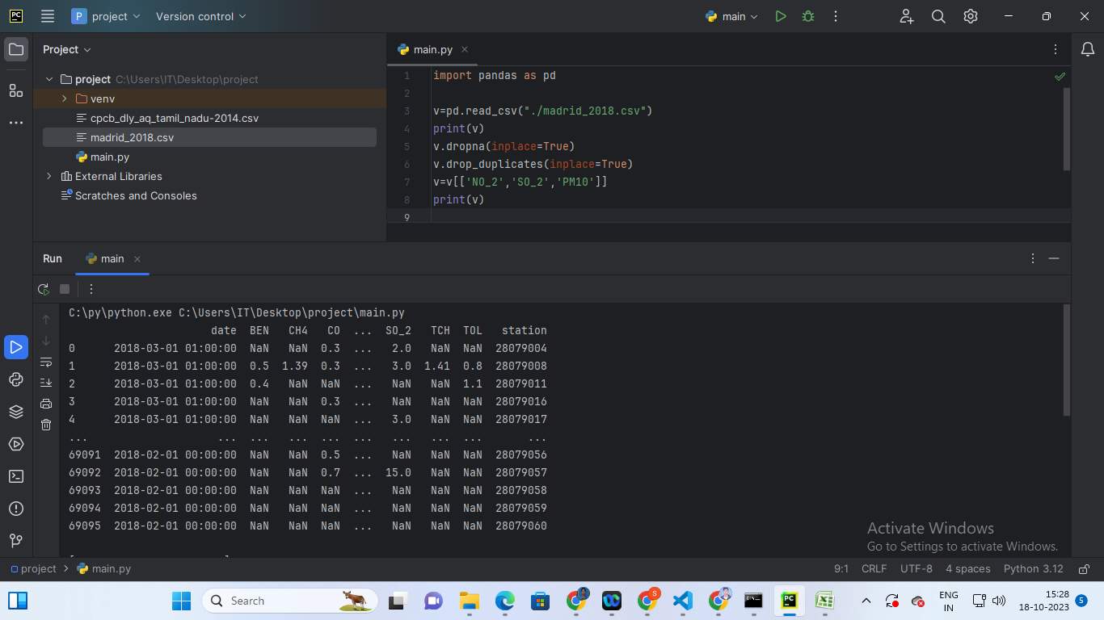
Before preprocessing and filtering:

Slide 12
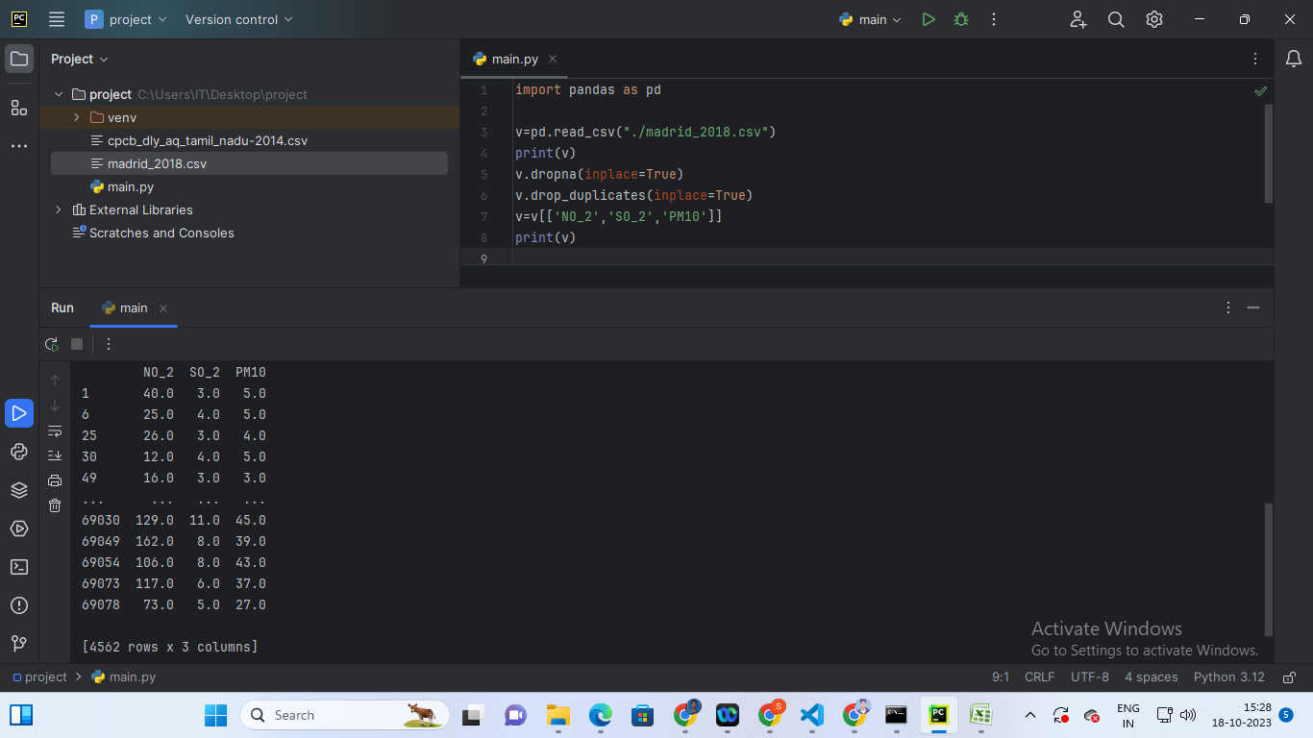
preprocessing and filtering:

Slide 13
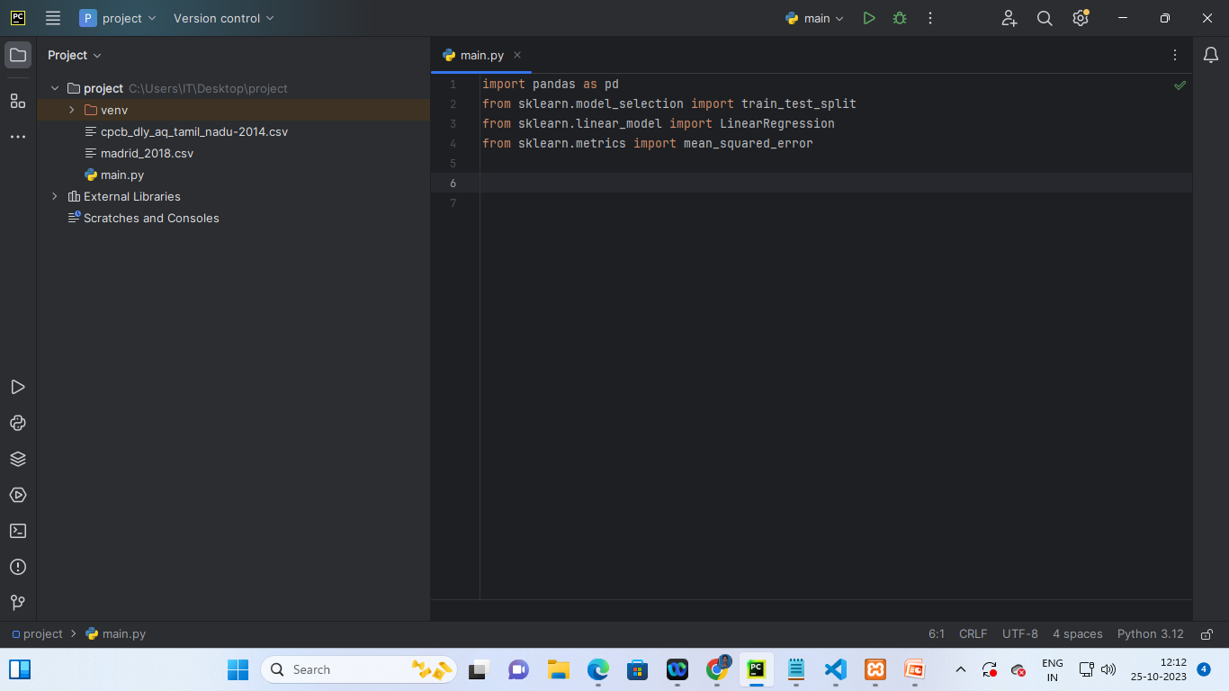
Importing packages:

Slide 14
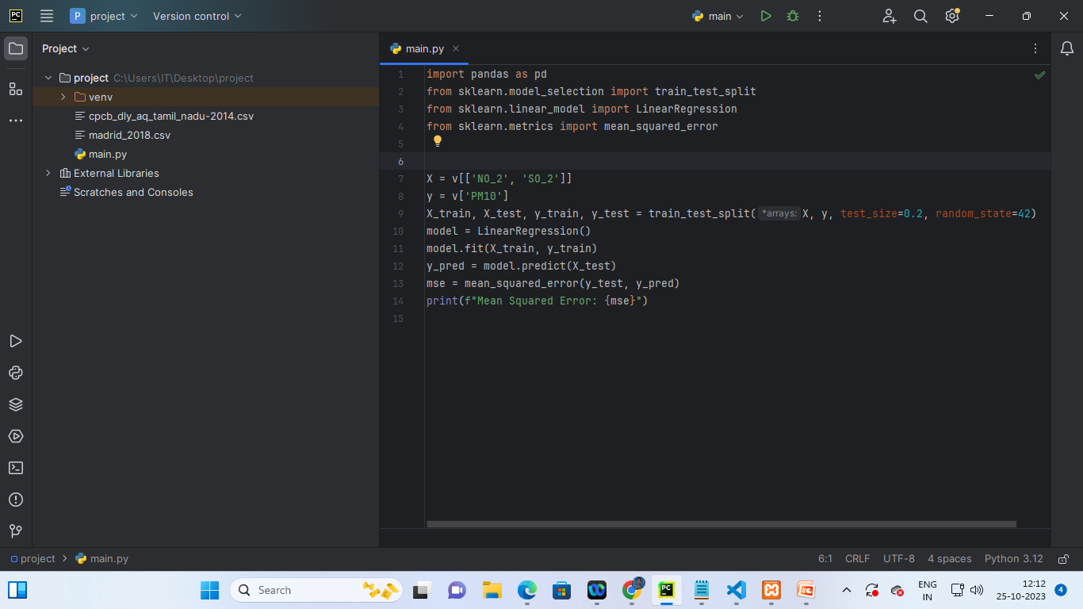
Program:

Slide 15
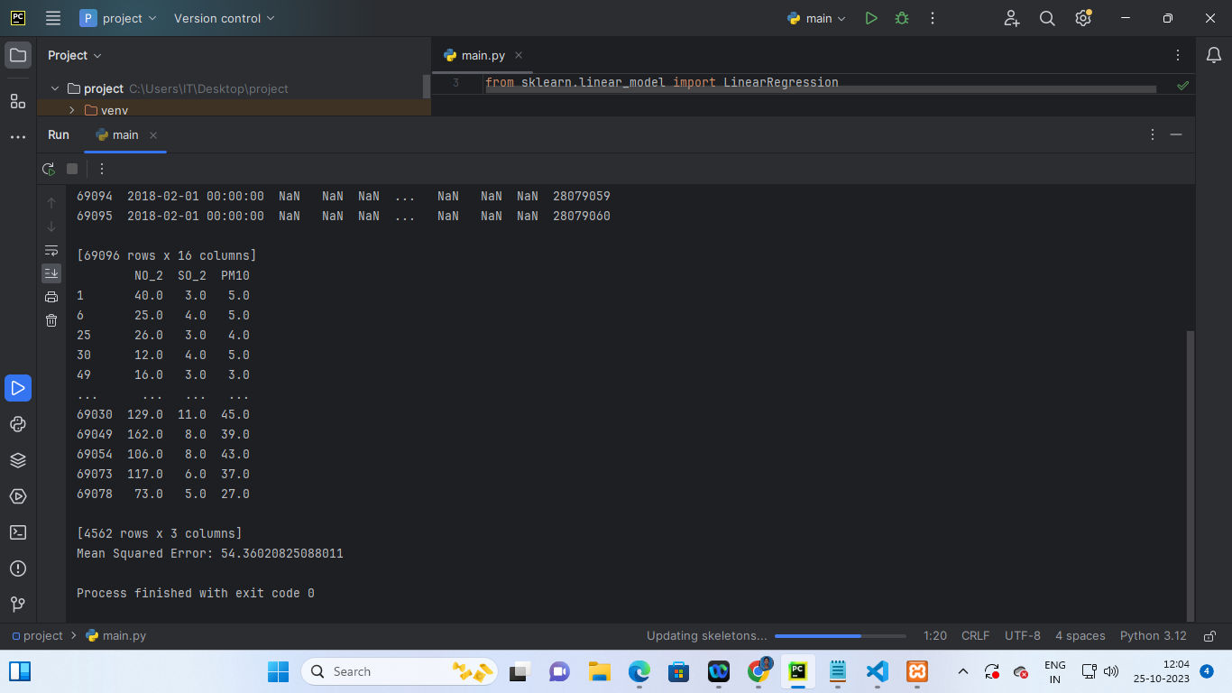
Output:

Slide 16
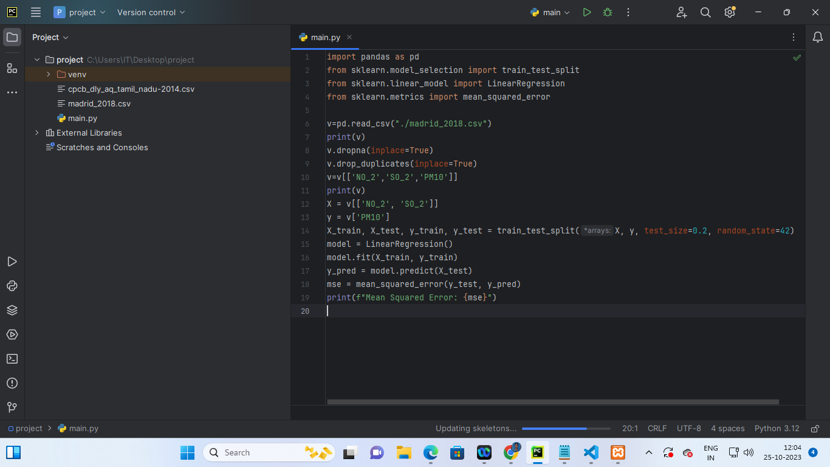
If you want entire program:

Slide 17
CONCLUSION:
Air quality is a critical issue that affects the health and well-being of the people in Tamil Nadu.
The air quality monitoring system in Tamil Nadu provides valuable data for analysis and modeling. Predictive modeling techniques can be used to forecast future air quality conditions and inform policy decisions.
Moving forward, it is important to take action to improve air quality in Tamil Nadu. Some next steps include:
Implementing policies and regulations that reduce emissions from industrial and transportation sources. Encouraging the use of cleaner energy sources, such as renewable energy and electric vehicles. Increasing public awareness and education about the impact of air pollution on health and the environment.

Slide 18
Thank you…

